Slide 1
Fake-News Detection
Presented By:
Arooj Ali -> BCSF18M534
Iqra Parveen -> BCSF18M534

Slide 2
Introduction
Fake news refers to information content that is false, misleading or whose source cannot be verified. This content may be generated to intentionally damage reputations, deceive, or to gain attention.

Slide 3

Problem Statement
Develop a machine learning program to identify fake/unreliable news based on content acquired.

Slide 4
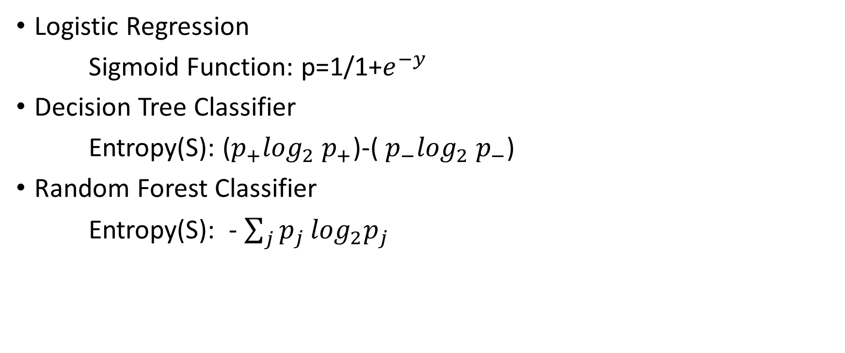
Algorithms Discussed for the Detection
Logistic Regression
Sigmoid Function: p=1/1+$e^{−y}$
Decision Tree Classifier
Entropy(S): ($p_{+}\log_{2}$ $p_{+}$)-( $p_{−}\log_{2}{ p}_{−}$)
Random Forest Classifier
Entropy(S): - $\sum_{j}{p_{j}}\log_{2}p_{j}$

Slide 5
Now Let’s Start Coding

